Slide 1
Agile Testing Being smarter about how we test by embracing simplicity and continuous improvement. Testers in an Agile/DevOps team.
Rob Moore
Principal Consultant, Readify
Matt Davies
Lead Consultant, Readify

Slide 2
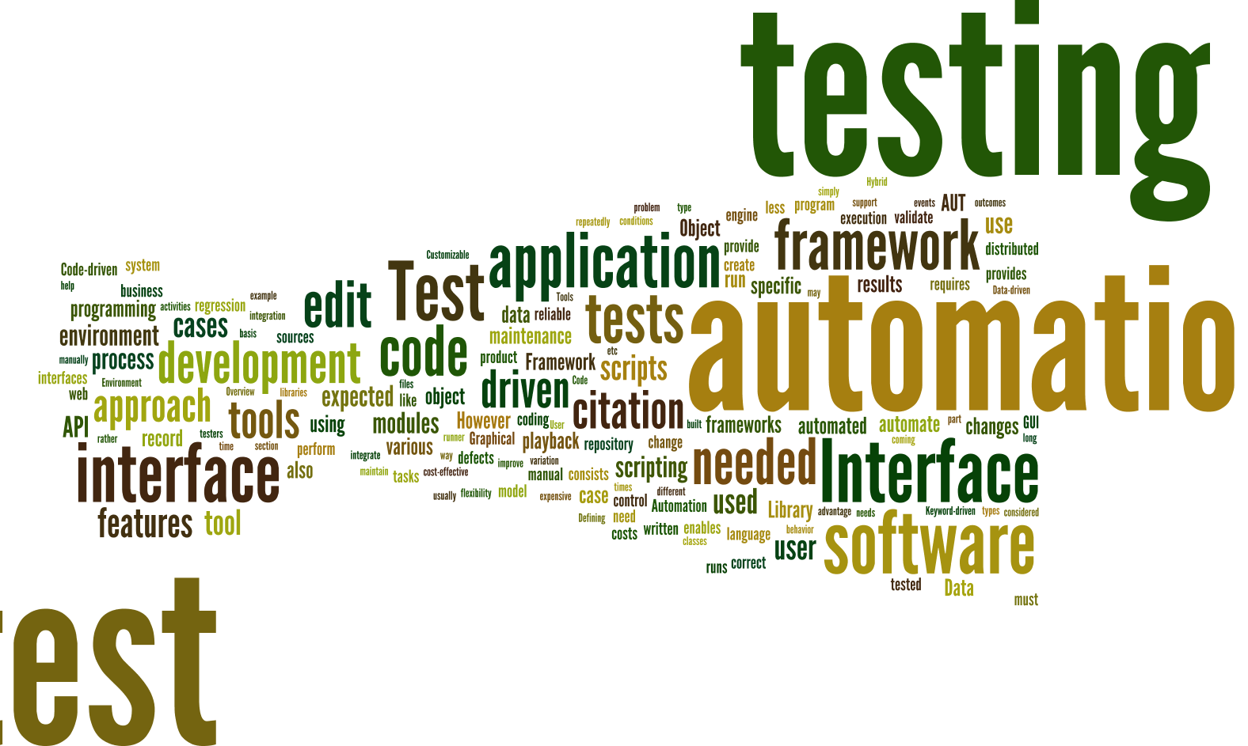
Notes:
Created by piping http://en.wikipedia.org/wiki/Test_automation into http://www.wordle.net/
As consultants we get to move within a number of different projects and industries.
Seen a lot of approaches over the last few years and seen what a lot of companies have done these
Experimented with a number of different approaches ourselves
Done a lot of research into what people are saying and doing

Slide 3

Notes:
http://en.wikipedia.org/wiki/Landfill
We’ve seen (and written) some awful, awful test code
Made our fair share of mistakes and learned a lot

Slide 4
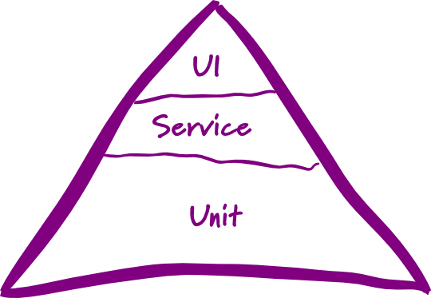
Testing pyramid
☹
Notes:
http://martinfowler.com/bliki/TestPyramid.html
This is the testing pyramid that you probably first heard about at uni – you have a breakdown of tests that looks something like this:
Most organisations we go into either have limited testing, or have an approach based on something like this. We see this everywhere.
Mostly low level unit tests
A smaller of number of service level or integration tests
An even smaller number of UI or system level tests
[transition]
I hate the testing pyramid. There are 3 Problems I have with it:
You have to care about the type of tests rather than what confidence you’re getting from them – how many people waste time arguing if a test is unit/integration/etc.? That’s a WASTE OF TIME
One-size-fits-all approach for all your projects that doesn’t give you the flexibility we feel you need across projects
It also doesn’t take into account the relationship between speed and confidence…

Slide 5

Speed
?
vs confidence
Notes:
https://www.flickr.com/photos/davidvillarreal/8732245026/
Speed vs confidence
By speed we mean speed of feedback – how quickly do we get feedback as to whether or not the codebase is ok
Confidence – how much certainty do your tests give you that your software is okay

Slide 6
* Ignoring other factors – this is just looking
at speed and confidence
Speed
“unit” tests
real database calls
UI testing
Manual testing
Confidence
Notes:
Automated or UI testing – all other considerations aside (human error, reliability etc) those two forms of testing take a lot of time to run but give you a lot of confidence the system is working because they act as a real user and exercise the entirety of the system as a user would.
Unit tests – super quick feedback but you aren’t exercising the system as a user is – so you aren’t as sure that all the pieces are working together correctly.

Slide 7
Jimmy Bogard’s testing pyramid
😐
Slow as
hell
Slow
Fast
Notes:
(Rob)
https://vimeo.com/68390508
Jimmy Bogard presented an alternative testing pyramid in his Holistic Testing talk at NDC Oslo in 2013.
Jimmy provides a breath of fresh air when throwing away the testing pyramid (and all the conflicting definitions of unit, integration, etc. tests) in favour of a pyramid that has a small number of “slow as hell tests”, a slightly larger number of “slow” tests and a lot of “fast” tests.
This is great as it helps us start to focus on something important about the tests – the speed of feedback – but doesn’t go far enough in my opinion since it doesn’t take confidence into account and is still a one-size-fits all strategy.

Slide 8

Our testing pyramid
☺
Notes:
We fundamentally disagree with the concept of a testing pyramid – as we’ve previous said, it’s too rigid and doesn’t you offer any flexibility between projects.

Slide 9

Our testing pyramid
☺
Notes:
Matt
(we really mean it, this is serious)

Slide 10
“The ultimate goal here is to ship code it’s not to write tests; tests are just a means to the end of shipping code.” “I can have 100% code coverage and have noone use my product and I can have 0% code coverage and it’s a huge success; there is no correlation between the two things.”
Jimmy Bogard
Confidence, rather than coverage, is key
Notes:
Quoted from his Holistic Testing talk at NDC 2013.
https://vimeo.com/68390508

Slide 11
“Testing is the process of evaluating a product by learning about it through experimentation, which includes to some degree: questioning, study, modelling, observation and inference. All the automated tests in the pyramid cannot be classed as an evaluation of a product by learning via experimentation. They are essentially CHECKS.”
Hamish Tedeschi, MagenTys
We need to accelerate the time to get to real users
Notes:
https://prezi.com/c5hrzba-wmxb/magentys-devops/
http://www.meetup.com/Perth-Agile-Testing/events/212586832/
In a continuous delivery world where we want to innovate and rapidly release software incrementally we can deal with uncertainty about what users want by embracing “testing” in this context. But in order to achieve this and make full use of our investment in continuous delivery we need to decrease the feedback loop to real users and then take advantage of that by getting quantitative and qualitative feedback.

Slide 12
Speed of release
You can only release when you meet your minimum confidence level.
Speed of release
Fear of refactoring
Manual regression testing
Wasted time fixing obvious regressions
Slow, brittle tests
Lot’s of time spent testing
Automated “checks”
Notes:
(Rob)

Slide 13
tl;dr * Speed and confidence are inversely proportional * Testing pyramid is too rigid – we can be smarter * Speed up releases via checks; then facilitate real testing

Slide 14
So, how do we decide on a testing strategy then?

Slide 15
“Challenge yourself to start simple then inspect and adapt”

Slide 16
Setting a testing strategy
Challenge yourself to set a minimum confidence level that is as low as possible
Create a testing strategy that meets that confidence level as fast as possible
Adjust the testing strategy over time based on observations (inspect and adapt)
Notes:
Go back to original point on confidence.
1. Most stakeholders will say 100% confidence but that actually means you’ll never get anything shipped out the door. Being pragmatic, we actually want to challenge ourselves to set our confidence level as low as possible for our business needs. in combination with techniques like continuous delivery, we can optimise our testing strategy to be able to react quickly and efficiently to mistakes that do happen.
2. Increases agility and supports CD
3. Your first attempt at this doesn’t have to be right – but it should be simple.
How many bugs are getting to production?
How fast is your team delivering features?
How confident or scared are you when your product is pressing the button to deploy to production?

Slide 17
Is that an oversimplification?
Yes and no.
Notes:
So you might ask – Is that a simplification? Surely you don’t use one type of test (the fastest possible for a confidence level) across your whole app.
[Reveal]
Yes and no.
Confidence level needed will likely change across different parts of the application.
But, we typically start with a broad brush testing strategy and let the inspect and adapt cycle run it’s course. Besides, in most of the apps we work on the majority of the application will be very similar, and then a few parts of it will be “special” and need different treatment. That’s where the inspect and adapt bit comes in to save the day.

Slide 18
Say no to EnterpriseDrivenTesting
Keep it nimble (simple)
Embrace heterogeneity of testing (smart)
Actually change it (continuous improvement)
Notes:
So, because we work for enterprises, we need enterprise-driven right?
We need to set our strategy, show it at CAB and then apply it synergistically across the organization so they are all consistent.
Then we can hire a separate team of testers to roll out the testing strategy across all teams and keep the developers honest because we don’t trust them.
NO. Just stop.

Slide 19
Questions? Are you happy with amount of effort, overall confidence and speed of feedback (checks and tests)? How can you make testing simpler? How can you continuously improve your testing?

Slide 20
Subcutaneous testing
Notes:
A major part of the strategy that we have been using involves a technique called Subcutaneous Tests

Slide 21
UI
MVC Controller / MVVM View etc.
Subcutaneous Test
Domain / Services / Repositories etc.
Database
External System
Notes:
One-level below the UI e.g. MVC controller
Full stack of production dependencies wired in
Application-owned datasources wired in
External dependencies mocked out
Good speed/confidence balance between all UI tests and all “unit” tests

Slide 22
Advantages
Testing behaviour → acceptance criteria → ATDD, executable specification
High amount of confidence
Reasonably fast without the fragility of UI tests
Refactoring friendly ☺
Less: tedious mocking code

Slide 23

Silver bullet!?
Notes:
https://www.flickr.com/photos/eschipul/4160817135
Not a silver bullet, there are some disadvantages and some limitations you need to be aware of. There are ways of working around or dealing with them though.

Slide 24
Disadvantages
Hard to get complete coverage of complex code
Combinatorial explosion
Hard to know why broken
Multiple test failures
Test complexity – lots of moving parts
Notes:
Explain the points, then look at the ways around them:
Complex code – use a different type of test (or combine)
Hard to know why broken – stack traces and the debugger are you friend along with good code organization and small number of layers in your code, your test tooling can help too –the BDD framework I use makes it easier to isolate for instance
Multiple test failures – pick one, focus on fixing it then re-run all tests
Test complexity – refactoring and use patterns – see my subcutaneous testing talk to .NET UG

Slide 25
What about “unit” tests?

Slide 26
Implementation tests (“unit” tests)
In-memory, in-process, low-level, implementation-focussed
Lightning fast, but lower confidence
Inhibits ability to safely/painlessly refactor
Important tool in the right situation
Useful to drive impl/support of complexity
Decision point – throw away or keep?

Slide 27
What about automated UI tests?

Slide 28
Automated UI tests
High confidence
Slow and fragile
Great for complex UIs and high-value scenarios
It’s a cost-benefit trade-off: don’t blindly cover everything in them – be smart

Slide 29
What testing strategy have we found effective?
Notes:
(Matt)
There’s a particular style of testing that we’ve generally settled on in projects we’ve worked on in the last year which has worked well for the type of application we’ve been working on.

Slide 30
Context
Small to Medium line-of-business apps
Many industries: education, telecomm., financial
Relatively small proportion of complex code
Not real-time / life-or-death
Using continuous delivery
Mixture of AngularJS, Xamarin and ASP.NET
Notes:
(Matt)
Another note is that we will inspect and adapt this testing strategy throughout a project.

Slide 31
Example testing strategy
Subcutaneous tests for ASP.NET MVC/AngularJS controllers, AngularJS directives and Xamarin view models
In-memory full stack HTTP server requests for ASP.NET Web API
Small, but judicious use of convention tests, route tests, integration tests, “unit” tests, end-to-end tests and UI tests
Notes:
(Matt)

Slide 32
The role of testers in a Agile/DevOps team

Slide 33
Testers
DevOps != Dev + Ops
Testing mindset = Gold
Backlog refinement
Kick-off
Collaborative testing discussions

Slide 34
Thoughts
Advocate for end users
Advocate for speeding up the team
Don’t just follow the testing pyramid, do manual regression testing or automated UI testing
Be smarter and free up time to do high value tasks
Notes:
End users = UX and trying to get things out faster and then actually getting real feedback
Think about how testing can speed up and slow down the team and try and promote the former

Slide 35
High-value tasks
Limitless PD opportunities:
Exploratory testing
Penetration testing
Performance testing
Load testing
UX testing
A/B testing
Testing automation
…

Slide 36
tl;dr * Don’t be a sheep and follow the pyramid * Use your valuable testing mindset to support the team * The goal isn’t testing it’s speed and confidence! * Be smart & embrace simplicity and CI * Free up time to work on high value tasks

Slide 37
Thankyou! Questions?
https://github.com/MRCollective/AgileTestingPresentation
Rob Moore
Principal Consultant
@robdmoore
Matt Davies
Lead Consultant
@mdaviesnet

Slide 38
Further reading
http://robdmoore.id.au/blog/2015/01/26/testing-i-dont-even/
http://robdmoore.id.au/blog/2013/05/26/test-data-generation-the-right-way-object-mother-test-data-builders-nsubstitute-nbuilder/
http://robdmoore.id.au/blog/2014/01/23/test-naming-automated-testing-series/
https://vimeo.com/68375232
https://vimeo.com/68390508
http://bit.ly/microtesting
https://github.com/robdmoore/TestingPatternsWithDossierPresentation
https://github.com/robdmoore/SubcutaneousTestsPresentation

